Slide 1

CSE 301 Introduction to Probability Theory
Atif Hasan Rahman
CSE, BUET

Slide 2
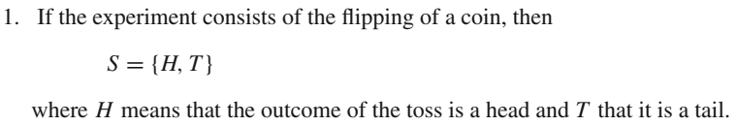
Sample Space
Suppose that we are about to perform an experiment whose outcome is not predictable in advance
But the set of all possible outcomes is known
The set of all possible outcomes of an experiment is known as the sample space of the experiment
denoted by S

Slide 3
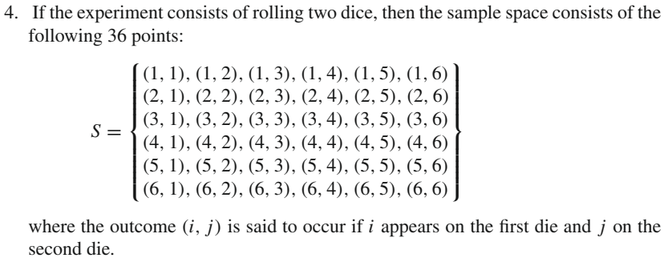
Sample Space

Slide 4
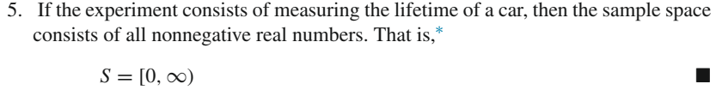
Sample Space

Slide 5
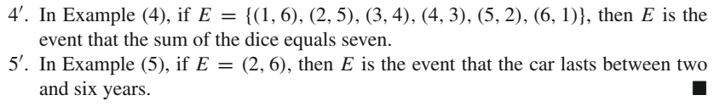
Events
Any subset E of the sample space S is known as an event

Slide 6
Union of Events
For any two events E and F of a sample space S
Union of events E and F, written E ∪ F, consists of all outcomes that are either in E or in F or in both E and F
That is, the event E ∪ F will occur if either E or F occurs
For example, in (1) if E = {H} and F = {T }, then E ∪ F = {H, T }

Slide 7
Intersection of Events
For any two events E and F,
EF (also written E ∩ F)
referred to as the intersection of E and F
EF consists of all outcomes which are both in E and in F
That is, the event EF will occur only if both E and F occur
For example, if E = {1, 3, 5} and F = {1, 2, 3}, then EF = {1, 3}

Slide 8
Mutually exclusive events
If E = {H} and F = {T }, then the event EF would not consist of any outcomes and hence could not occur
To give such an event a name, we shall refer to it as the null event and denote it by Ø
If EF = Ø, then E and F are said to be mutually exclusive.

Slide 9
Complement of an event
For any event E we define the new event E^{c} (complement of E) to consist of all outcomes in the sample space S that are not in E
That is, E^{c} will occur if and only if E does not occur
In Example (4) if E = {(1, 6), (2, 5), (3, 4), (4, 3), (5, 2), (6, 1)}, then E^{c} will occur if the sum of the dice does not equal seven
Also note that since the experiment must result in some outcome, it follows that S^{c} = Ø

Slide 10
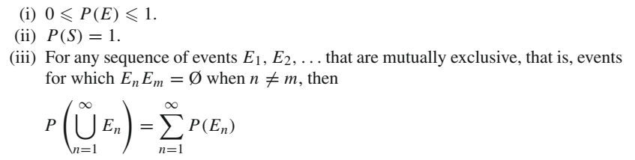
Probabilities Defined on Events
Consider an experiment whose sample space is S
For each event E of the sample space S, we assume that a number P(E) is defined and satisfies the following three conditions:

Slide 11
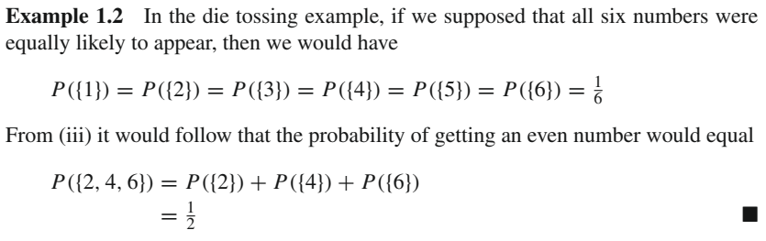
Probabilities Defined on Events

Slide 12
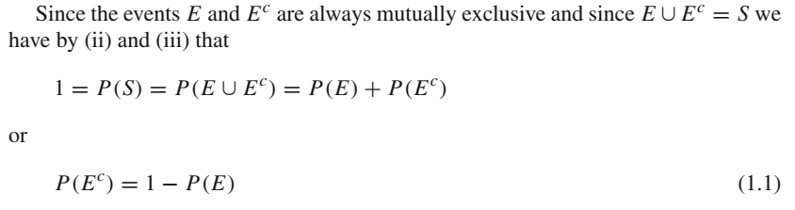
Probabilities Defined on Events

Slide 13
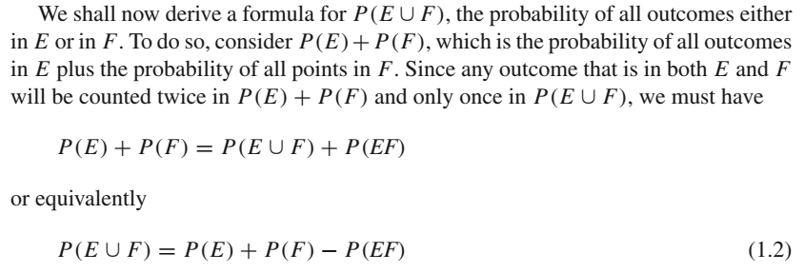
Probabilities Defined on Events

Slide 14
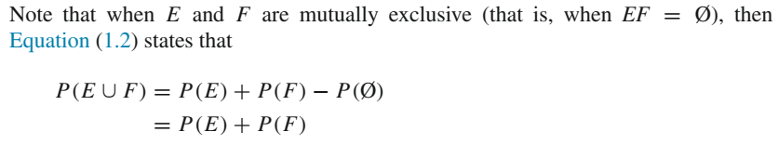
Probabilities Defined on Events

Slide 15
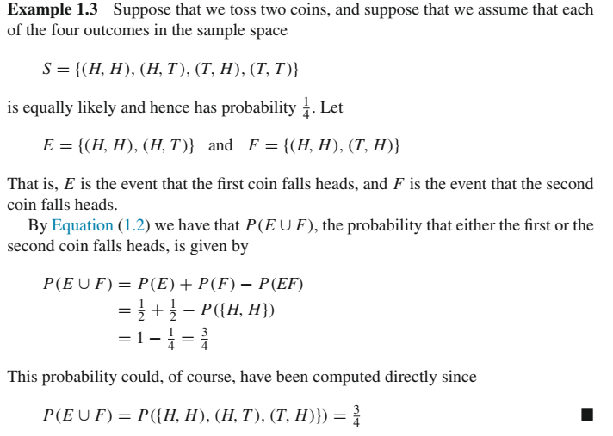

Slide 16


Inclusion-exclusion identity

Slide 17
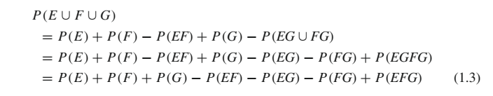
Inclusion-exclusion identity
Since (E ∪ F)G and EG ∪ FG are equivalent

Slide 18
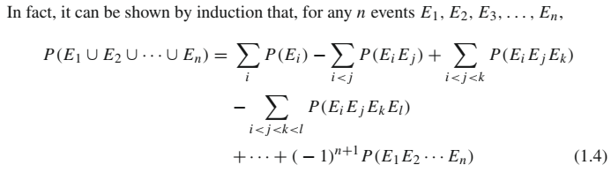
Inclusion-exclusion identity

Slide 19

Conditional Probabilities
If we let E and F denote two events, then the conditional probability that E occurs given that F has occurred is denoted by P(E|F)
If the event F occurs, then in order for E to occur it is necessary for the actual occurrence to be a point in both E and in F
that is, it must be in EF
Now, because we know that F has occurred
F becomes our new sample space
probability that the event EF occurs will equal the probability of EF relative to the probability of F
That is

Slide 20
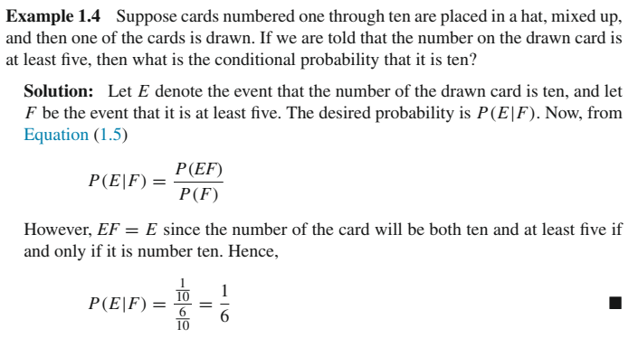
Conditional Probabilities

Slide 21
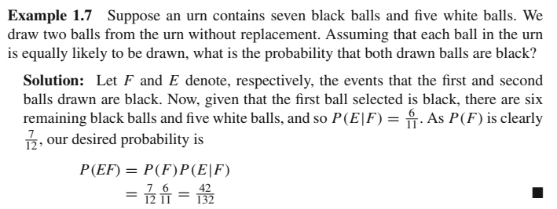
Conditional Probabilities

Slide 22
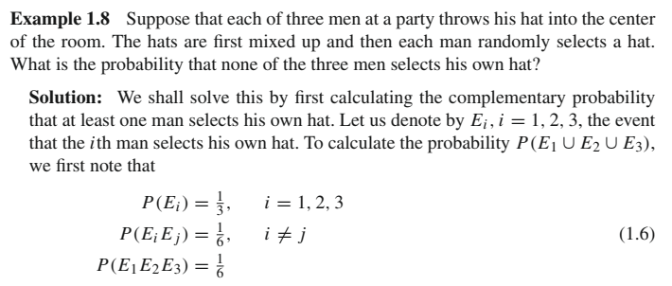
Conditional Probabilities

Slide 23
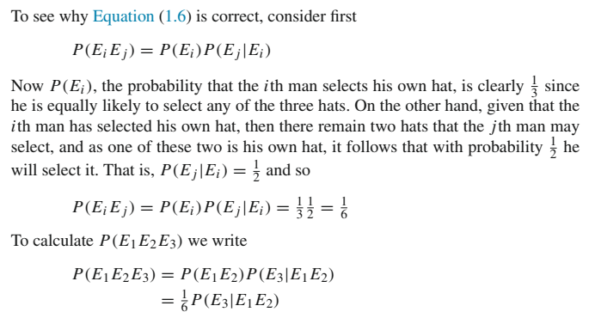
Conditional Probabilities

Slide 24
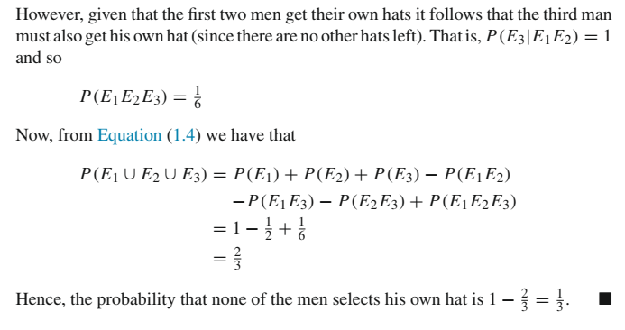
Conditional Probabilities

Slide 25
Independent Events
Two events E and F are said to be independent if P(EF) = P(E)P(F)
By Equation (1.5) this implies that E and F are independent if P(E|F) = P(E)
E and F are independent if knowledge that F has occurred does not affect the probability that E occurs
The occurrence of E is independent of whether or not F occurs.

Slide 26
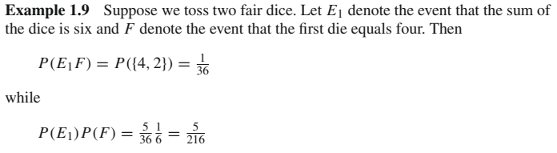
Independent Events

Slide 27
Independent Events
If we are interested in the possibility of throwing a six (with two dice), then we will be quite happy if the first die lands four (or 1, 2, 3, 5)
We still have a possibility of getting a total of six
On the other hand, if the first die landed six, then we would be unhappy
We would no longer have a chance of getting a total of six
In other words, our chance of getting a total of six depends on the outcome of the first die and hence E₁ and F cannot be independent

Slide 28
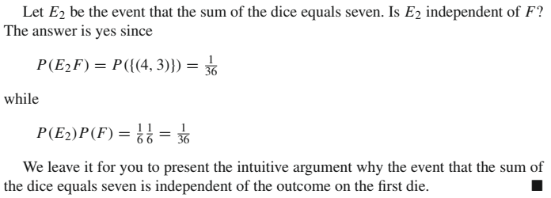
Independent Events

Slide 29
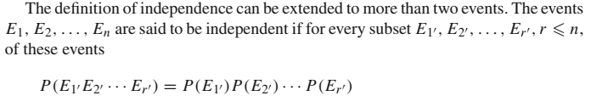
Independent Events

Slide 30
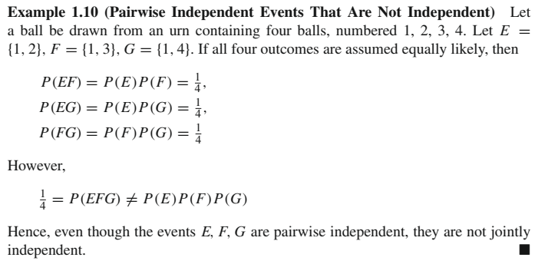
Independent Events

Slide 31
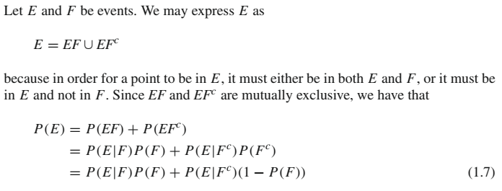
Bayes’ Formula

Slide 32
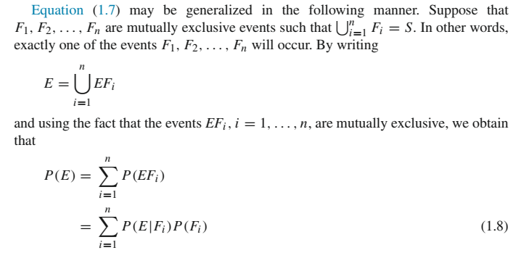
Bayes’ Formula

Slide 33
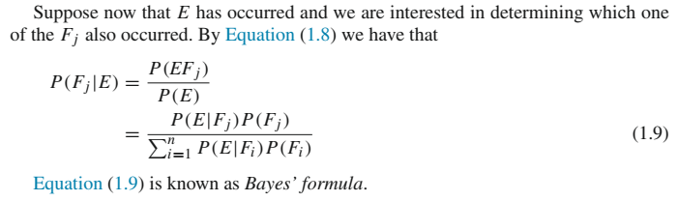
Bayes’ Formula

Slide 34
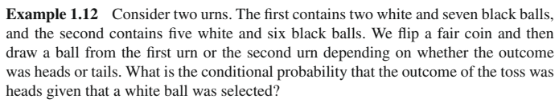
Bayes’ Formula

Slide 35
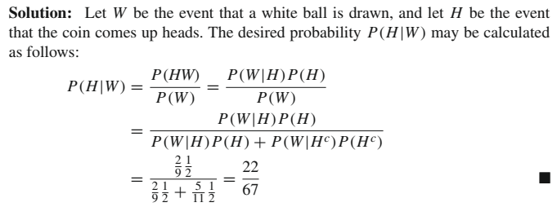
Bayes’ Formula

Slide 36
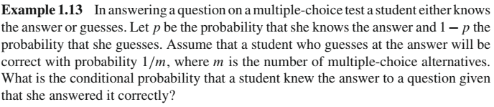
Bayes’ Formula

Slide 37
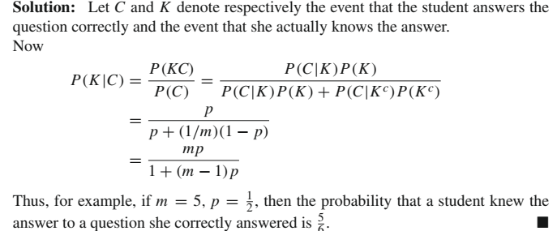
Bayes’ Formula

Slide 38
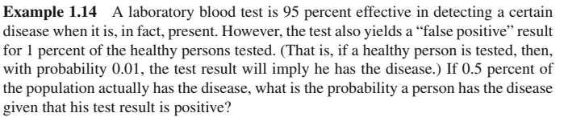
Bayes’ Formula

Slide 39
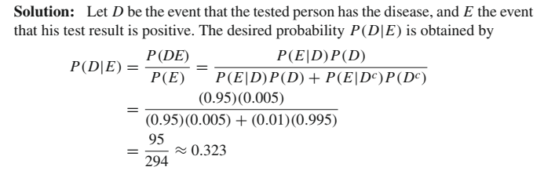
Bayes’ Formula

Slide 40
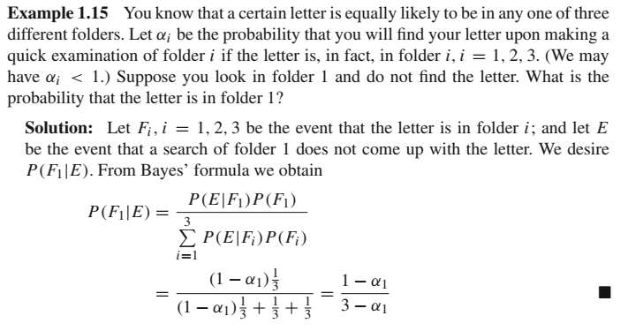
Bayes’ Formula

